Slide 1
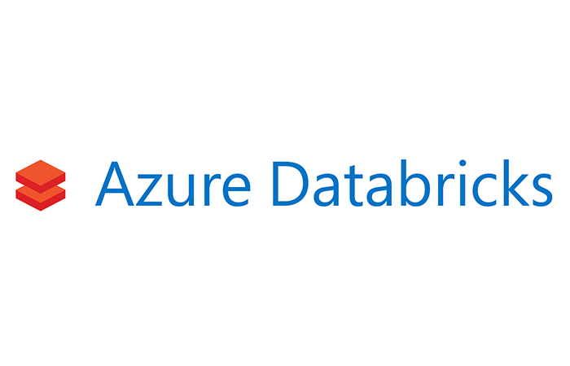

Slide 2


First Looks at Azure Databricks
Jean-Pierre(JP) Voogt
Twitter @JPVoogt
jvoogt1@gmail.com

Slide 3
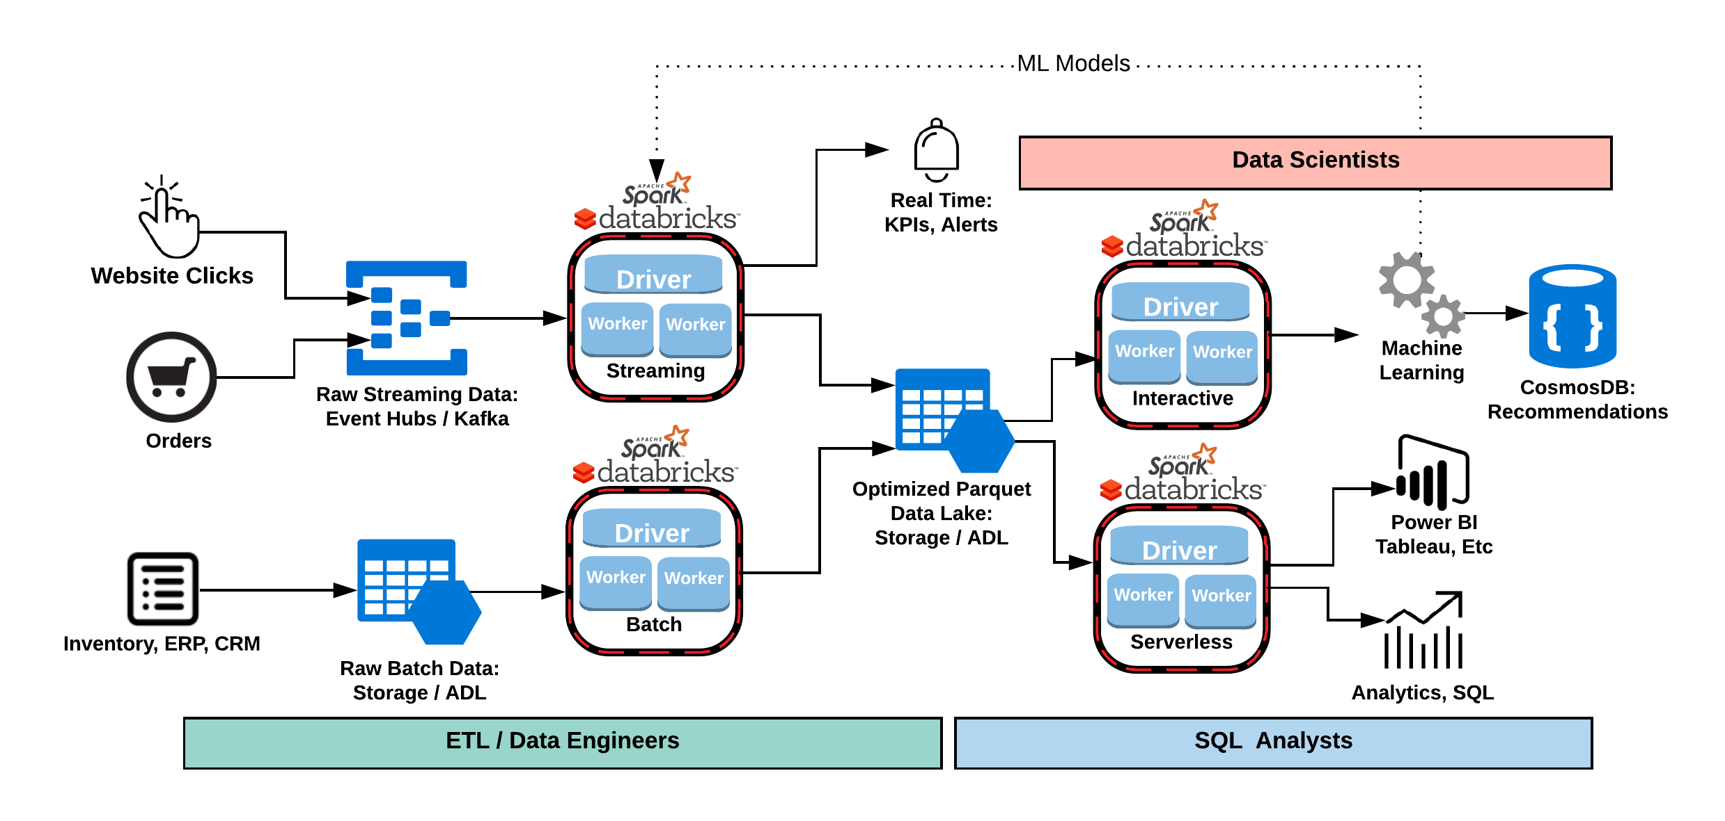
Some flash

Slide 4
Agenda
What is Azure Databricks
Why would you use Azure Databricks
Who would use Azure Databricks
Getting Started
Clusters
Notebooks
Some Data Stuff

Slide 5
What is azure databricks
https://docs.microsoft.com/en-us/azure/azure-databricks/what-is-azure-databricks
Azure Databricks is an Apache Spark-based analytics platform optimized for the Microsoft Azure cloud services platform. Designed with the founders of Apache Spark, Databricks is integrated with Azure to provide one-click setup, streamlined workflows, and an interactive workspace that enables collaboration between data scientists, data engineers, and business analysts.

Slide 6
Why
Read and process huge files and data sets
Query, explore, and visualize data sets
Join disparate data sets found in data lakes
Train and evaluate machine learning models
Process live streams of data
Perform analysis on large graph data sets and social networks

Slide 7
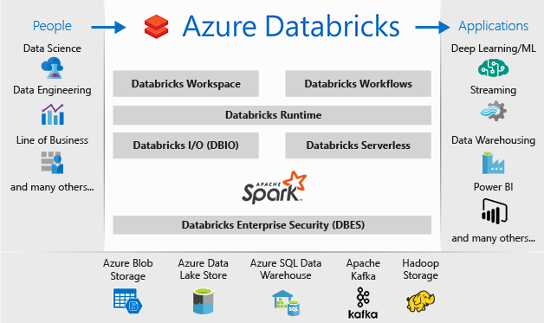
Who would use azure databricks

Slide 8



Supported Languages
Scala - https://www.scala-lang.org/
Python - https://www.python.org/
R - https://www.r-project.org/
Spark SQL - https://bit.ly/2wfjeq4

Slide 9
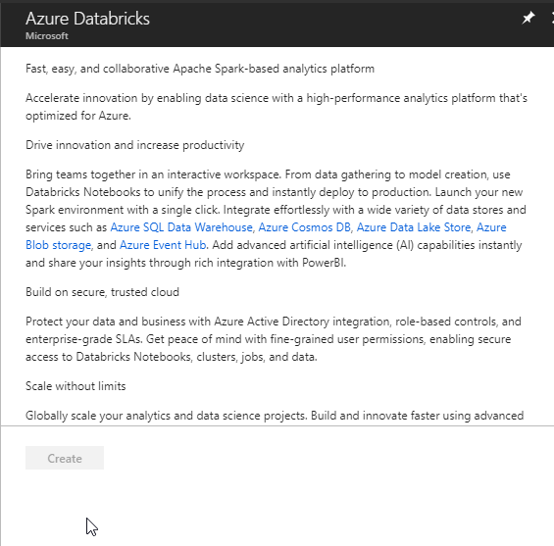
Getting Started

Slide 10
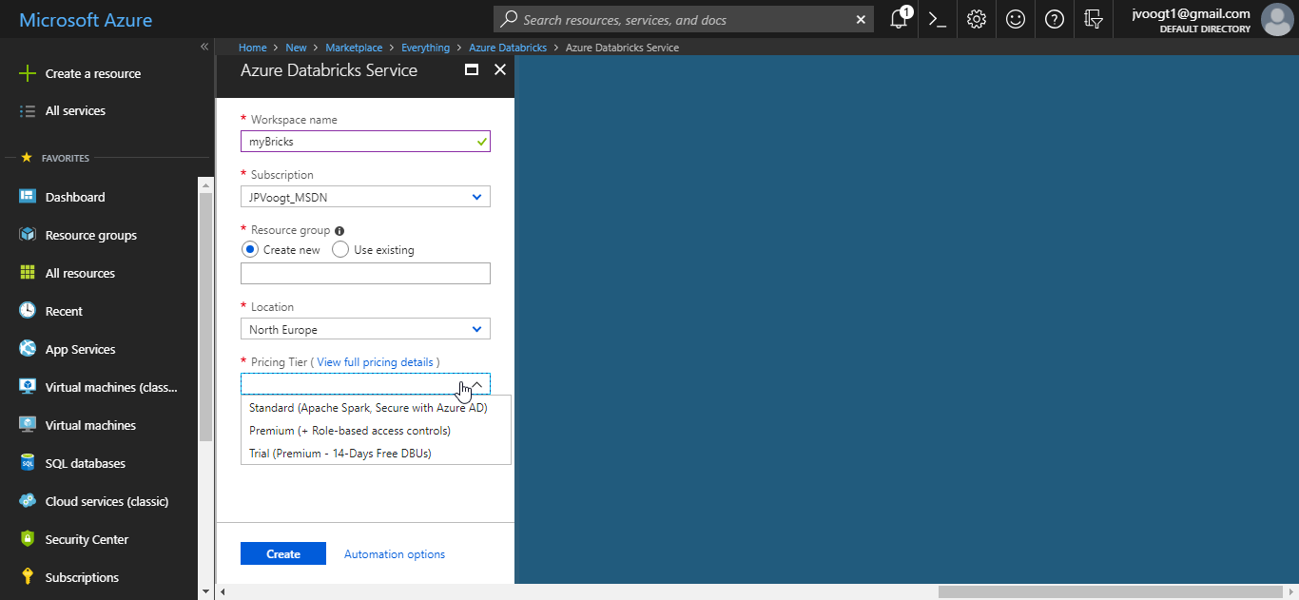
Getting Started

Slide 11
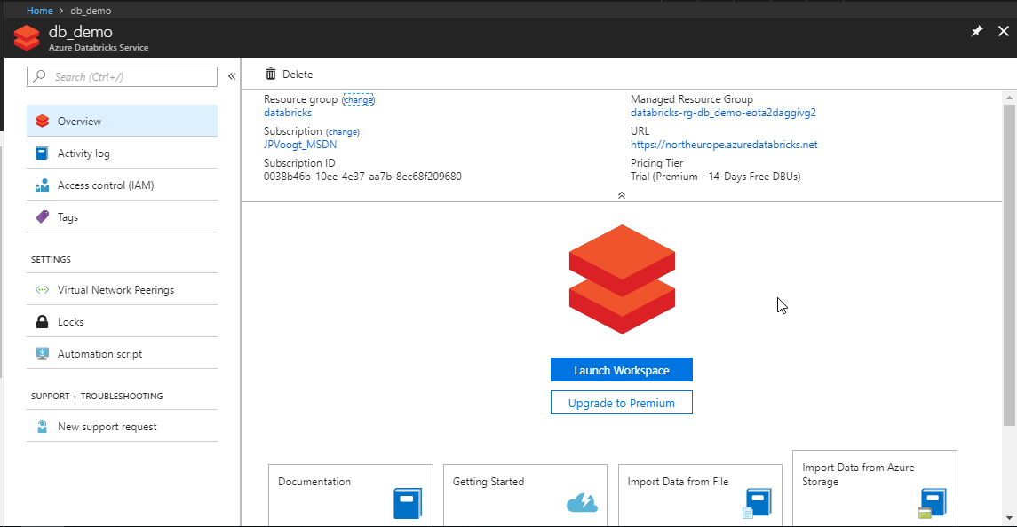
Getting started

Slide 12
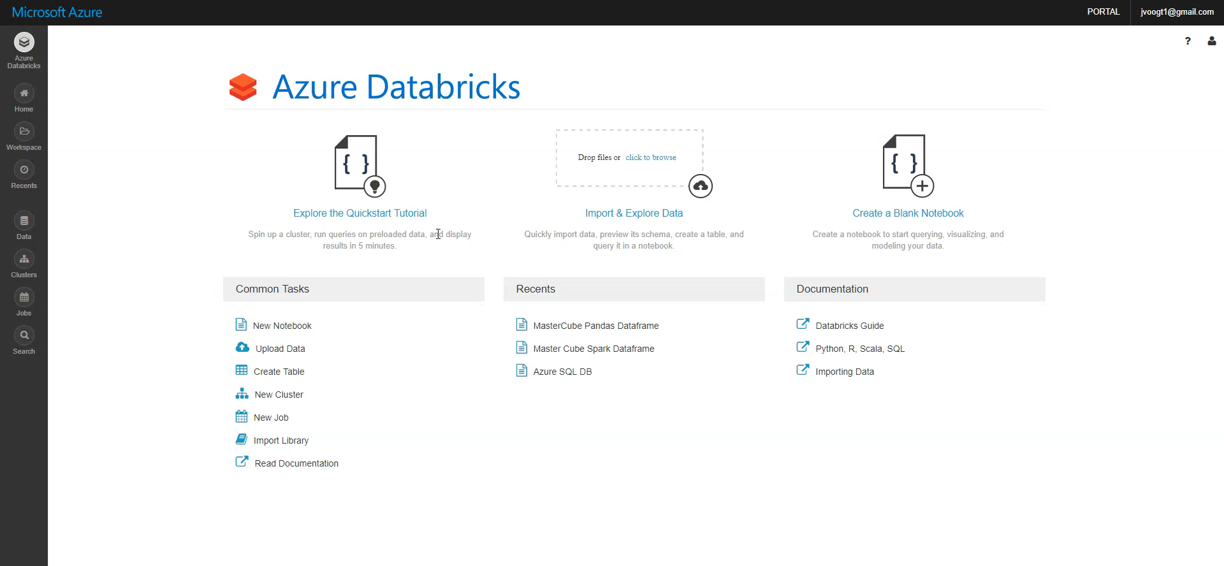
Creating a Cluster

Slide 13
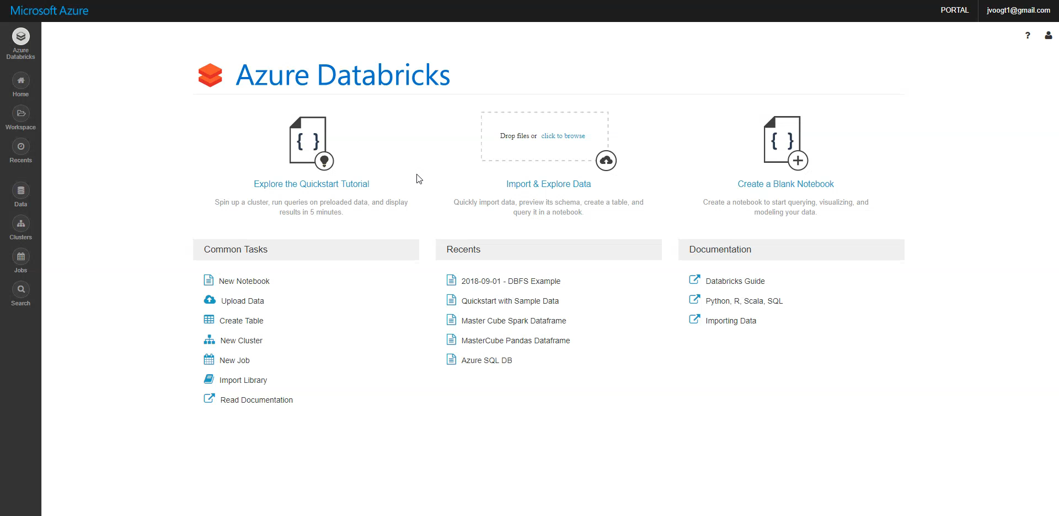
Importing data

Slide 14
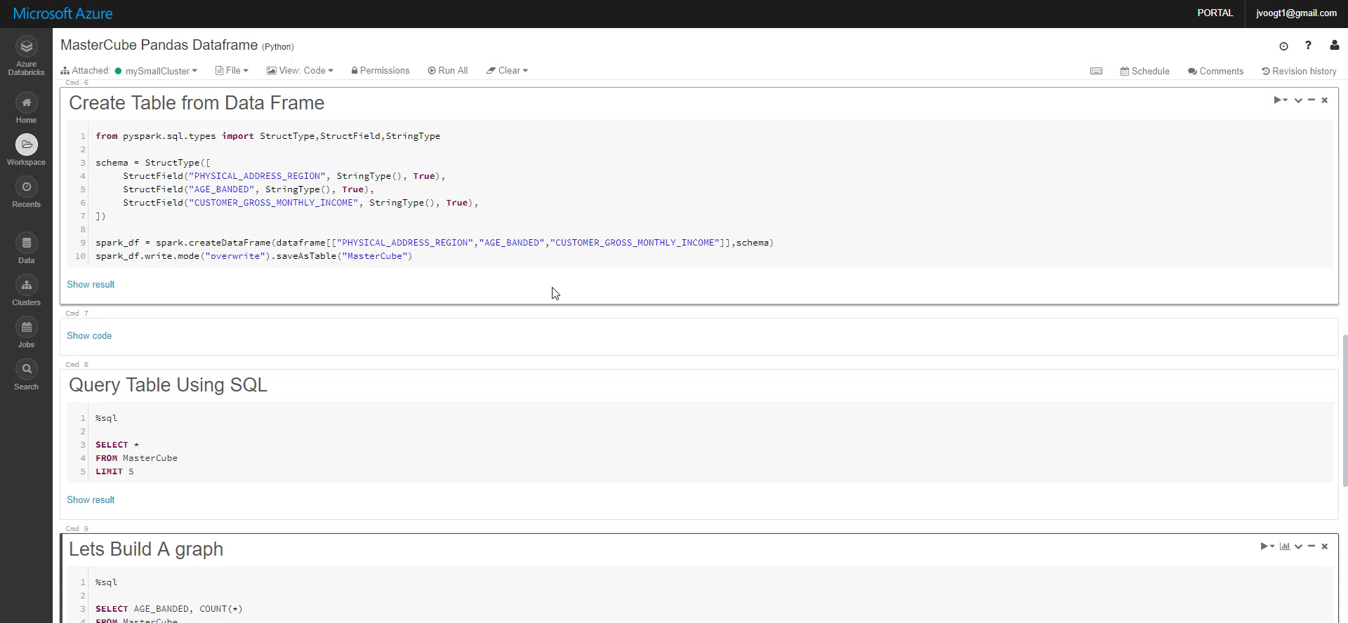
Notebook basics

Slide 15
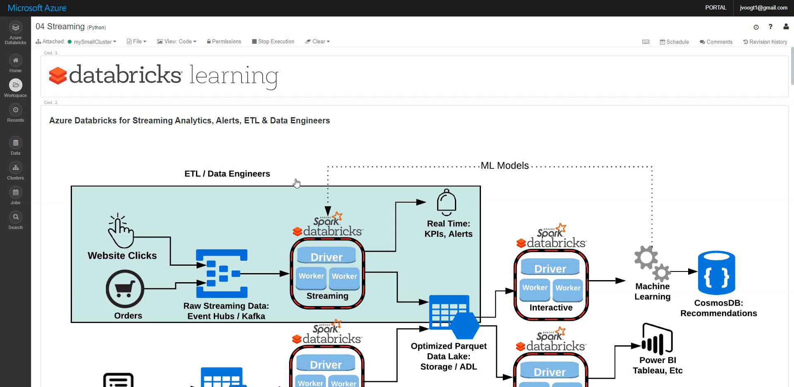
Notebook Dashboards

Slide 16
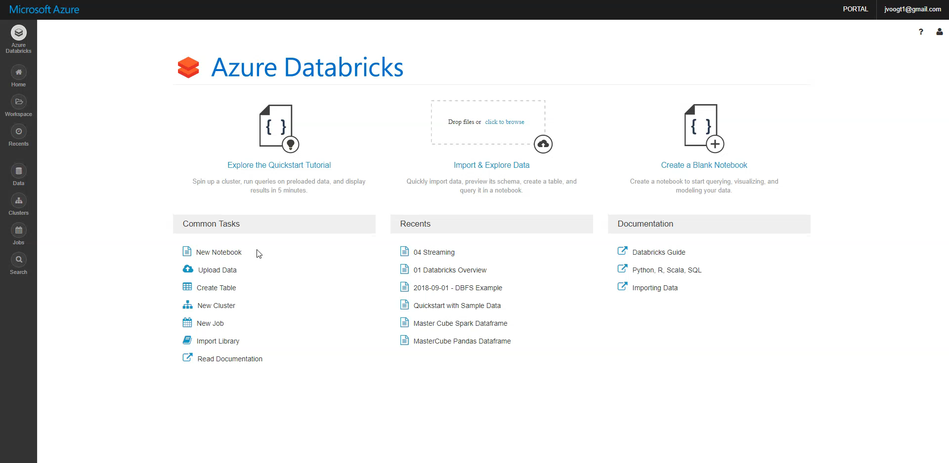
Jobs

Slide 17
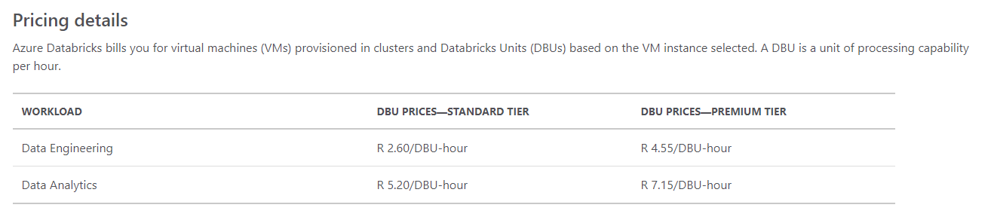
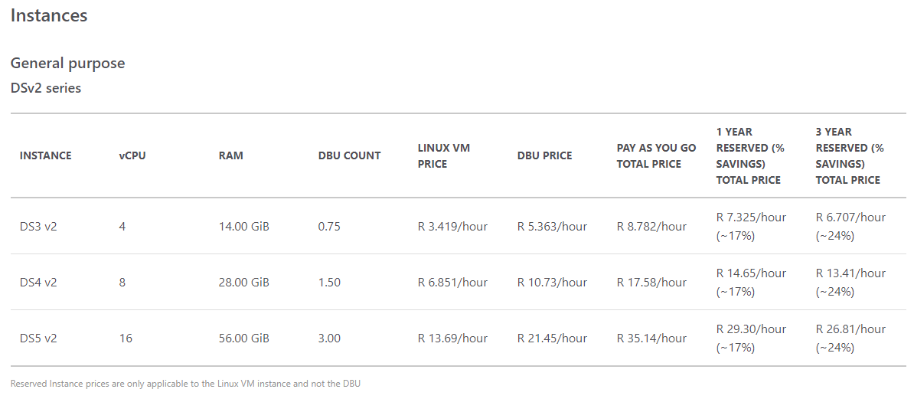
Pricing

Slide 18
Extra Reading MATERIAL
https://docs.azuredatabricks.net/index.html
https://www.kaggle.com/

